Slide 1



Mini Project - Data Analysis
Lydia Manzanares
Data Science and Machine Learning

Slide 2
Intro to database
Unicorn company
Transnational data set which contains all the transactions occurring in 1 year
Main customer are wholesalers
There is no missing value

Slide 3

Challenge
Prepare 10 business questions for insights in the dataset
Clean up the dataset
Practice sql skills and answer the business questions
Bonus for visualization or web scrapping

Slide 4

Data Cleaning
Filter the data to only analize 6 months (01-01-2011 to 31-06-2011)
Invoice transactions which the quantity is negative or zero or unit_price = 0 are consider returns

Slide 5
Analysis

Slide 6
Dashboards links
Sales Analysis
Returns Analysis

Slide 7
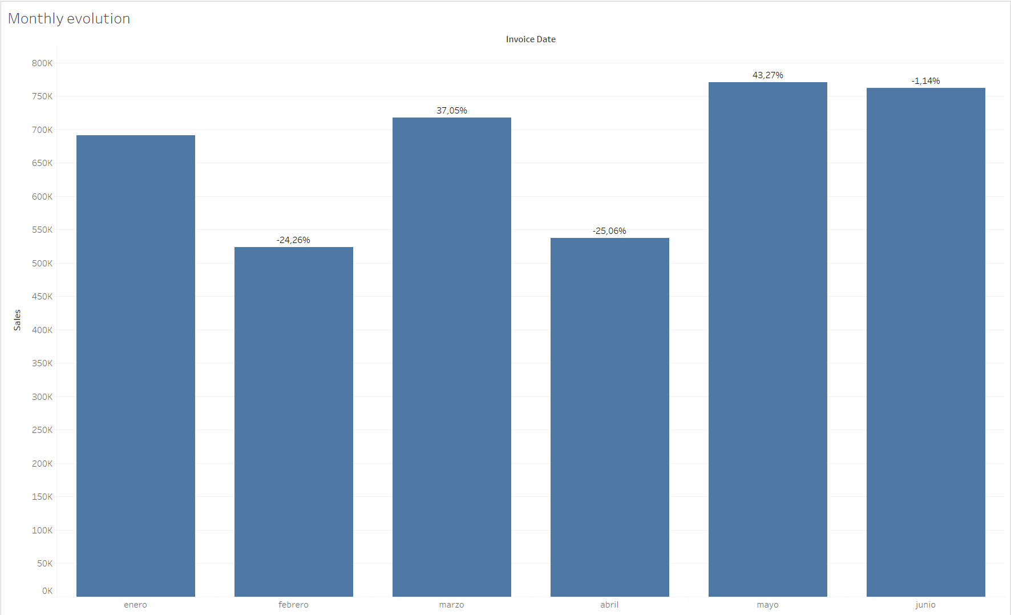
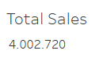
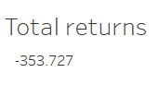
Sales

Slide 8
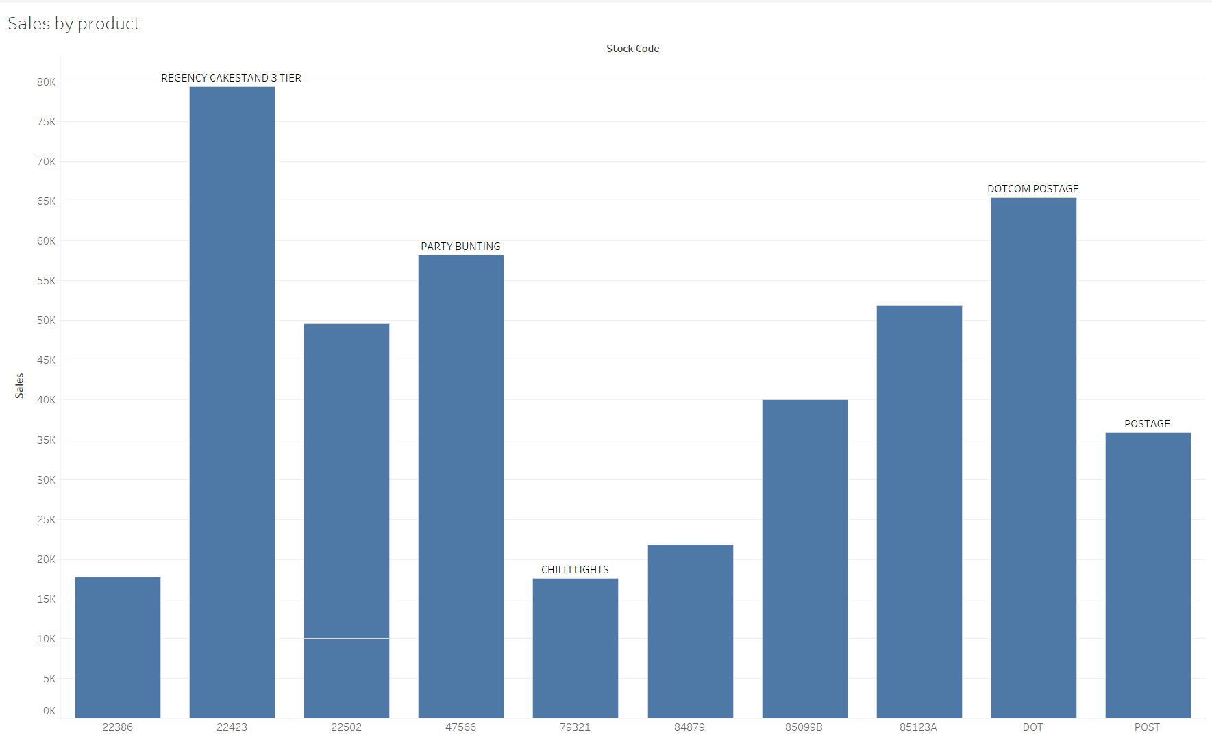
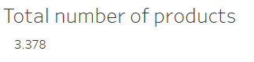
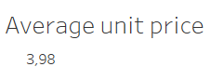
Products

Slide 9
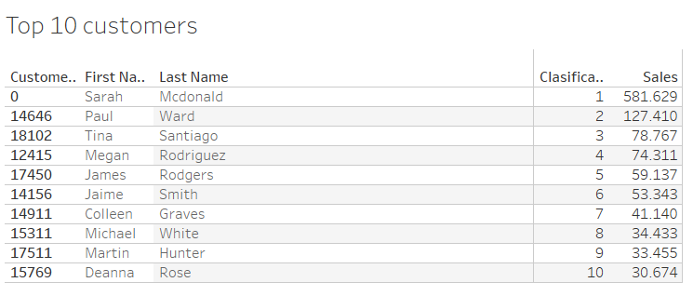
Customers
Total number of customers
4373

Slide 10
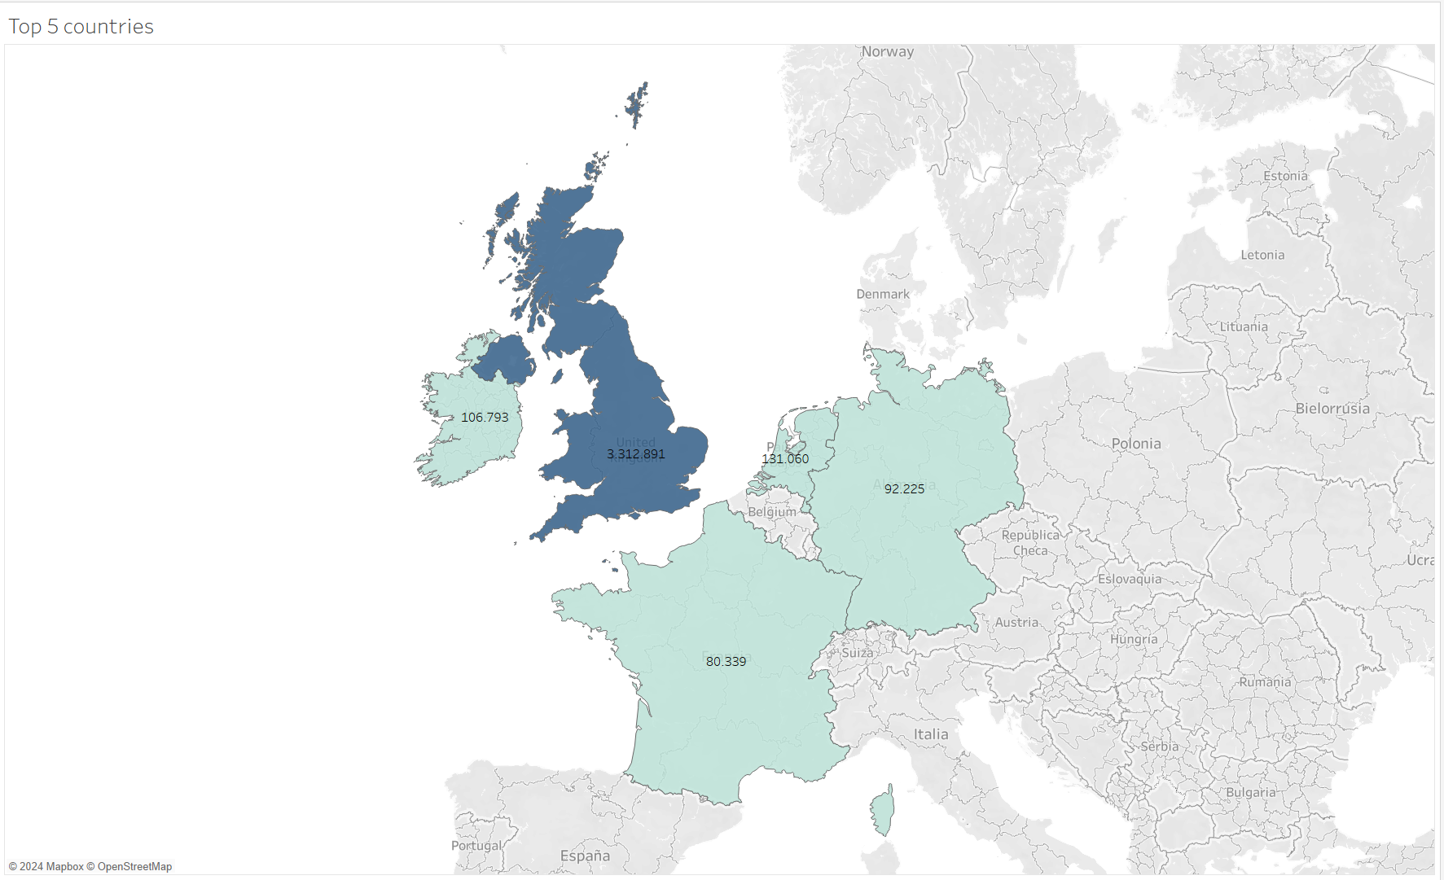
Countries
Total number of countries
36

Slide 11

Questions?
Thank you!

